Slide 1

NAME :H K BHASKAR EMAIL:bhaskarvirat50@gmail.com Mobile: 8296102385
Description:
PPT presentation on the projects done

Slide 2
PROJECT :1 “CONTROLLING A ROBOT USING BLUETOOTH”
OBJECTIVE
To control a robot with help of Bluetooth headset and DTMF android app.
To reduce complexity of circuit.
Controlling a system without using any programming boards either Arduino or Microcontrollers etc

Slide 3
INTRODUCTION
In the present-day scenario with the development and advancement of technology we ﬁnd new innovation coming in a more profound into our lives. Nowadays IOT works have increased a lot in our society. The principle goal of this mini project is to design a simple Robot using a DTMF and Bluetooth.
This particular robot basically aimed at eliminating the limitations of rang. The locomotion of robot in different directions can be controlled and maneuvered by pressing the assigned keys on the DTMF app. The robot is controlled by an android app (DTMF APP) that generates tone and transmits to Bluetooth which is attached to the robot. In this course of call if any button on the controller mobile phone is pressed, a tone corresponding to the button pressed is heard at the other end. This tone is called as the DTMF tone. The robot perceives this DTMF tone with the help of a Bluetooth stacked to the robot. This tone is processed by DTMF decoder with the help of a MT8870 DTMF decoder. The MT8870D then transmits a signal to the motor’s driver IC-L293D to operate the motors. According to the decoded values the motors will run either forward or backward.

Slide 4
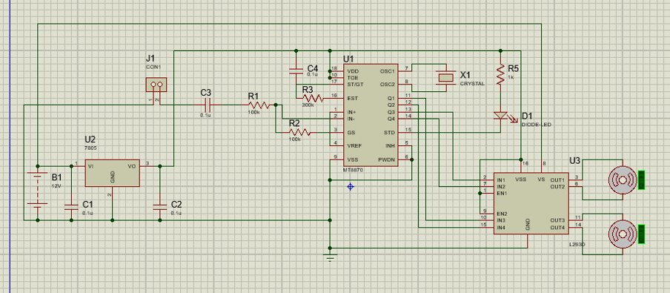
CIRCUIT DIAGRAM

Slide 5
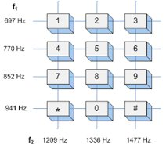
WORKING
DTMF: (DUAL TONE MULTI FRIQUENCY)
Signalling system for identifying the keys.
Combination of two sine wave tones to represent a key.
These tones are called row and column frequencies as they correspond to the layout of a telephone keypad

Slide 6
BLUETOOTH
Bluetooth is an open wireless technology standard for transmitting fixed and mobile electronic device data over short distances.
Range of Bluetooth is dependent on its class and primarily there are three classes of Bluetooth:
Class 1 transmitting at 100 mW with a range of 100 meters or 328 feet.
Class 2 transmitting at 2.5 mW with a range of 10 meters or 33 feet
(most Bluetooth headsets and headphones are common Class 2 devices)
3.Class 3 transmitting at 1 mW with a range of fewer than 10 meters.

Slide 7
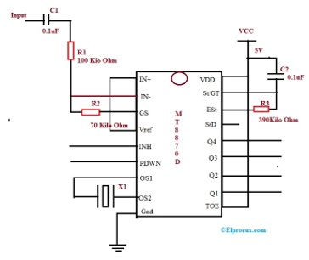
DTMF DECODER: (MT8870)
This circuit detects the dial tone (DTMF Tone) from a telephone line.
Decodes the keypad pressed on the remote telephone.
A complete communication consist of the tone generator and the tone decoder.

Slide 8
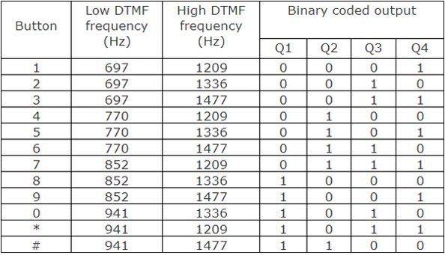
OUTPUT TABLE

Slide 9
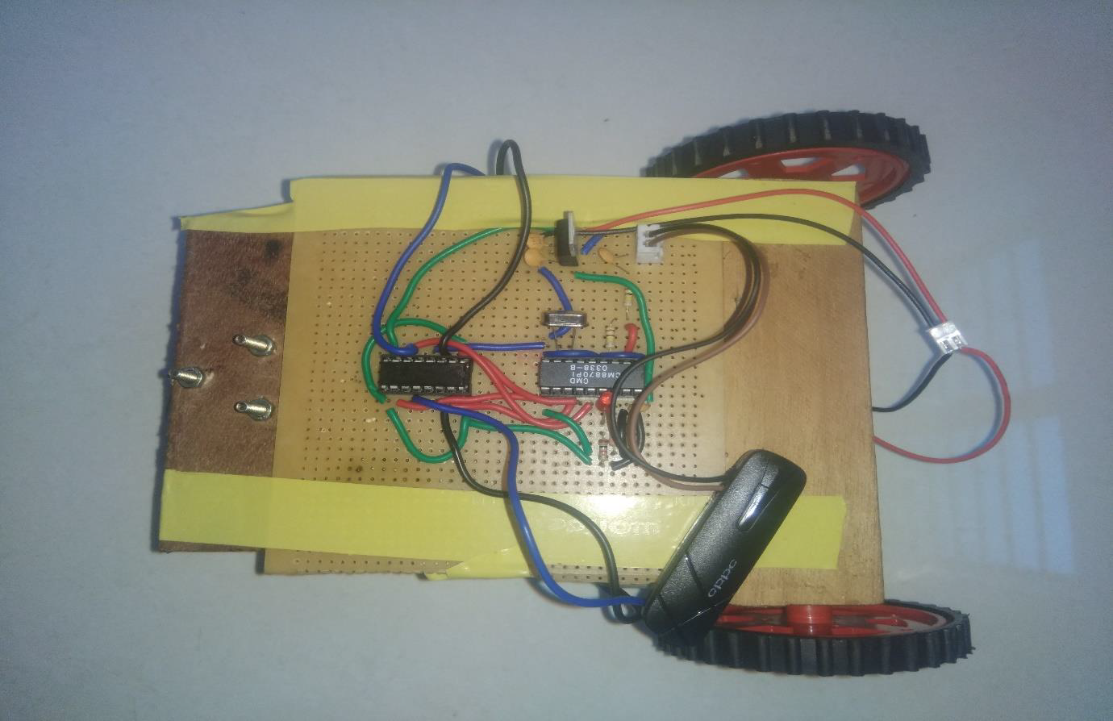
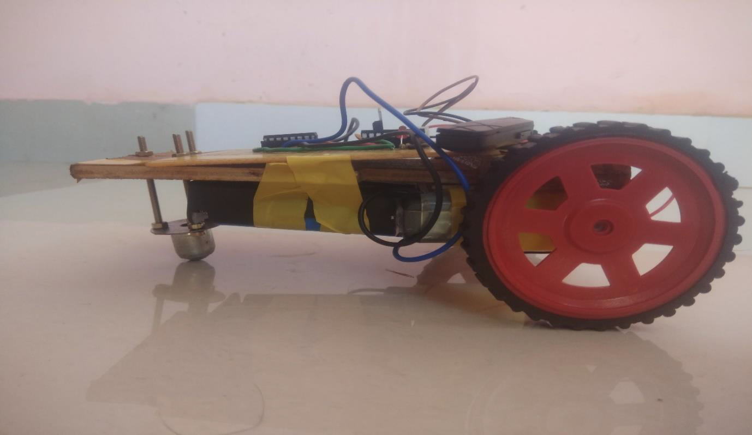
WORKING MODEL

Slide 10
CONCLUSION
The design which is proposed to work as a robot is actualized with features as mentioned in the above sections. The circuit can be changed to suit any necessary application. The device is planned and realized successfully and it is ready to be utilized.
The working of the circuit can be further improvised by adopting the following points.
1.The speed of the robot can be controlled by using the gear motors.
2. The entire circuit can be implemented using still more effective android application for better device interface.

Slide 11
REFERENCES
Electronics For You (Magazine)
Website( www.efxkits.us)
https://electronicsforu.com/electronics-projects/hacking-bluetooth-headset-control-robot
https://people.ece.cornell.edu/land/courses/ece4760/FinalProjects/s2001/pr57/M-8870.PDF
https://www.rakeshmondal.info/L293D-Motor-Driver

Slide 12
PROJECT :2 “Secured means of entrance for examination hall using face recognition ”
Problem Statement:
To design a model to detect and recognize student face using python to enter the examination hall.
Objectives:
To develop a model for face detection and recognization.
To ensure enrolled student should enter the exam hall .

Slide 13
INTRODUCTION
Nowadays, the identity forgery used in exams are becoming more and more advanced. Test taking is a common method used for cheating in exams. Therefore, how to correctly recognize those forged identities has become a difficult issue in exam management. This project aims to design a face recognition system that can be used in the exam identity authentication system. This system integrates various advanced technologies, such as face image capturing, human-machine interaction, data transmission. In this system, handheld terminals feature low cost, compact size, various functionalities, and high scalability.

Slide 14
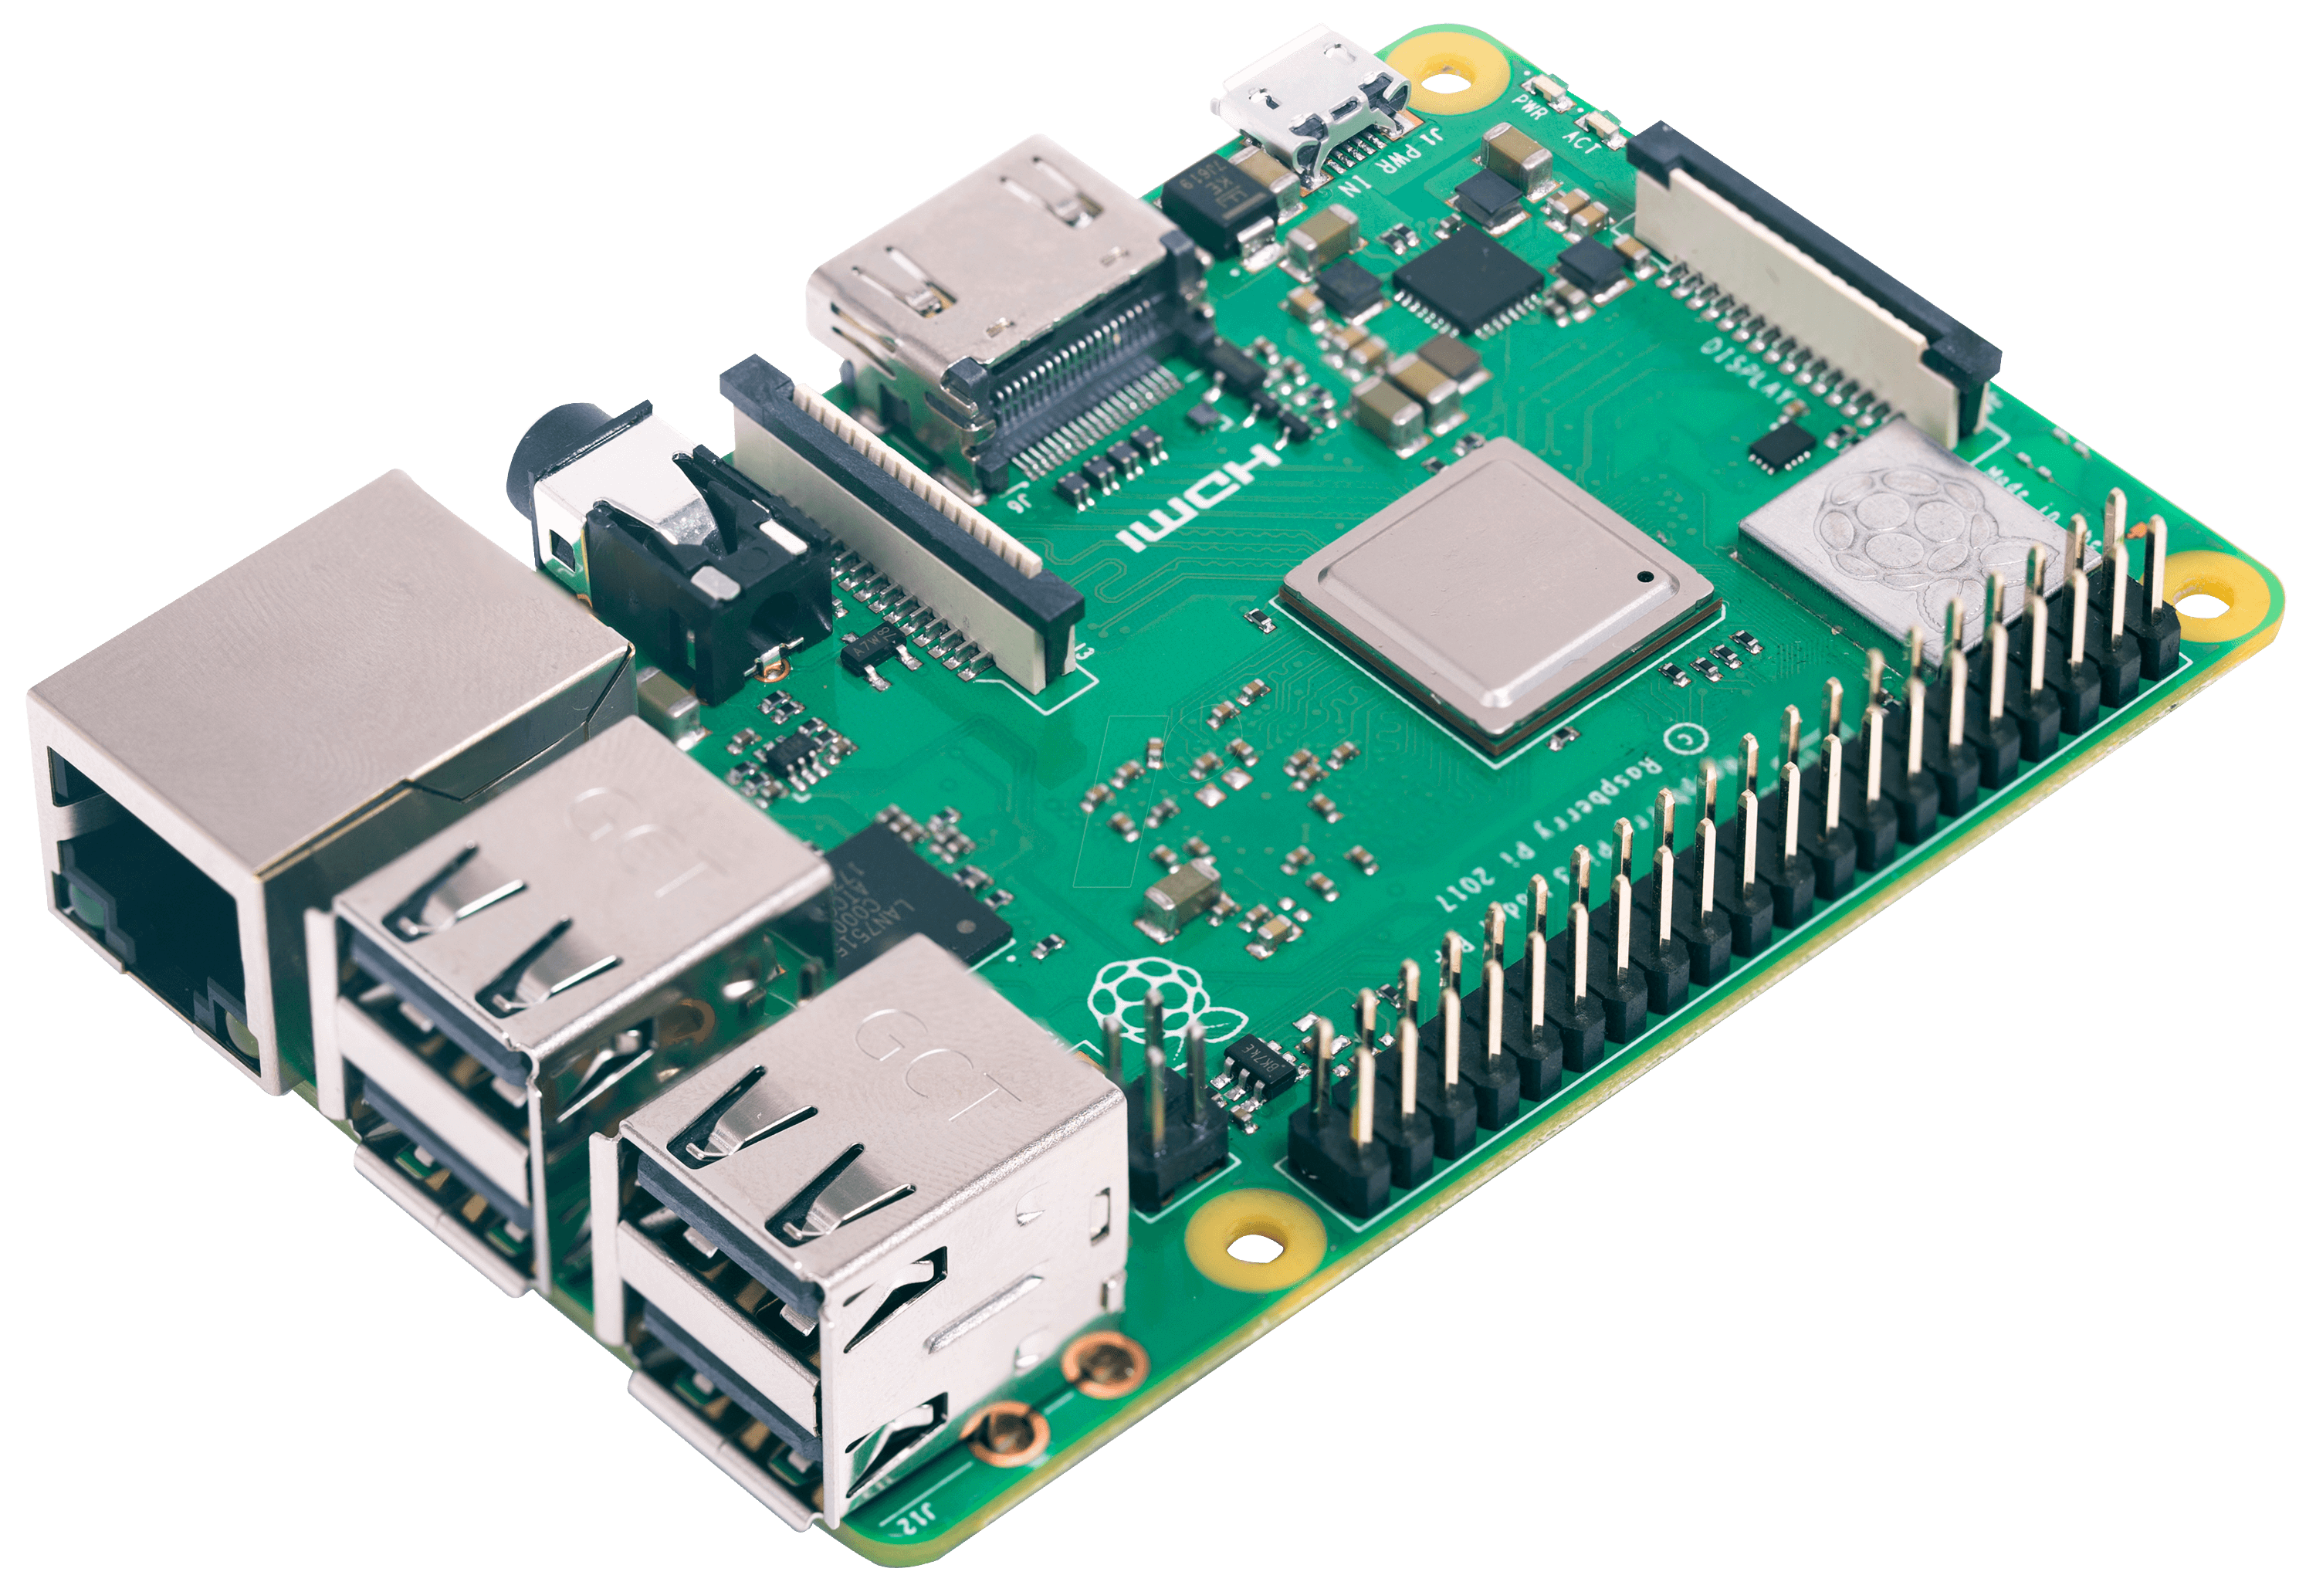
HARDWARE &SOFTWARE DESCRIPTIONS
Hardware:
Raspberry Pi
Pi Camera
Motion Sensor
servo motor
Software:
Raspbian Buster
open CV
Thonny IDE

Slide 15
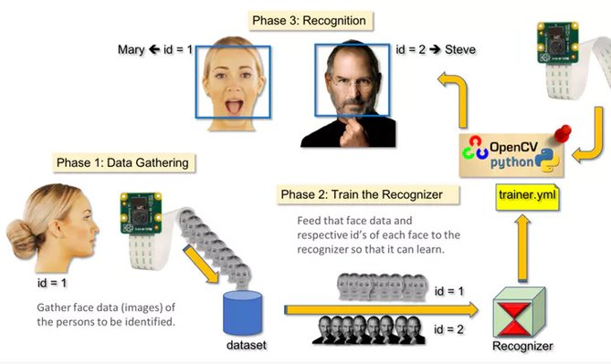
PROPOSED STSTEM

Slide 16
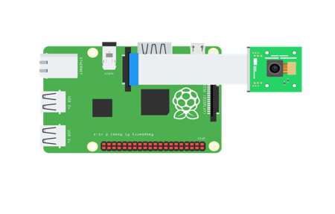
BLOCK DIAGRAM
This Includes the basic level of block diagram involved in the project.
Ultrasonic
sensor
Pi camera
Raspberry
pi
Servomotor

Slide 17
WORKING
Step I : Data Gathering
Face id of different students is collected using camera.
Collected data is framed into sets.
Step II : Train the Recognizer
Using the collected data sets Pi has to be trained.
Training is done with help of certain codes.
Step III: Recognization
The device compares input data(face) with trained data.
Id of matched face will be displayed.

Slide 18
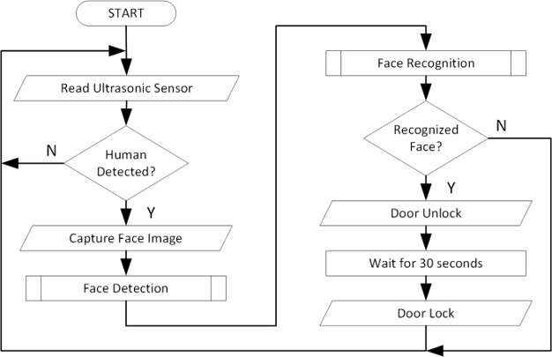
FLOW CHART

Slide 19
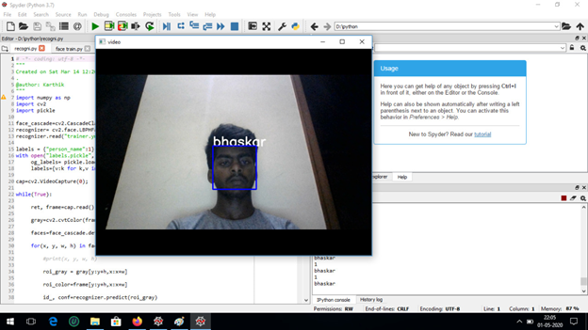
OUTPUT RESULTS

Slide 20
CONCLUSION AND FUTURE SCOPE
The whole world is using the facial recognition technology and enjoying its benefits and uses. There is a huge scope for this facial recognition technology in India and it is helping to improve the country in various process. This technology and its applications can be used across different segments of the country.
Prevention of the frauds at ATMs across India. The databases of all the customers of their respective banks along with their ATM cards in India can be created and facial recognition systems can be installed across all the ATM’s. So, whenever the user enters the ATM his photo will be taken and it will permit the access only after it is being matched with stored photo from the database.
Duplicate voters can be easily identified in India.
Verification of passport and visas can also be done using this technology.
Driving license verification can be done easily done using the same approach.

Slide 21


